Slide 1
Snapshots of BBA @JUIT

Slide 2
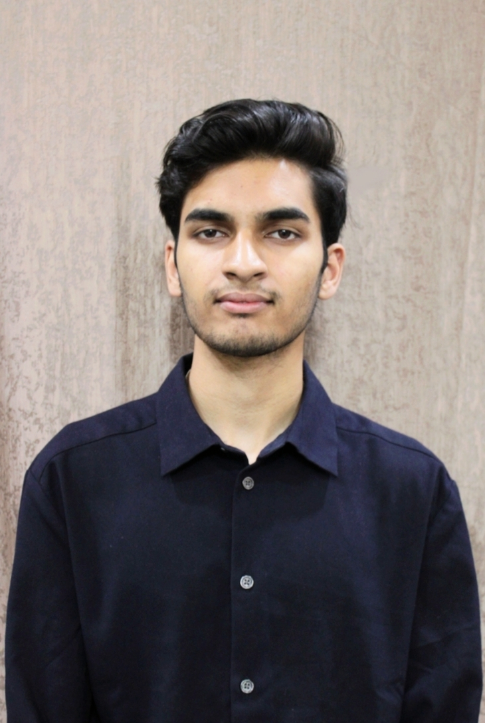
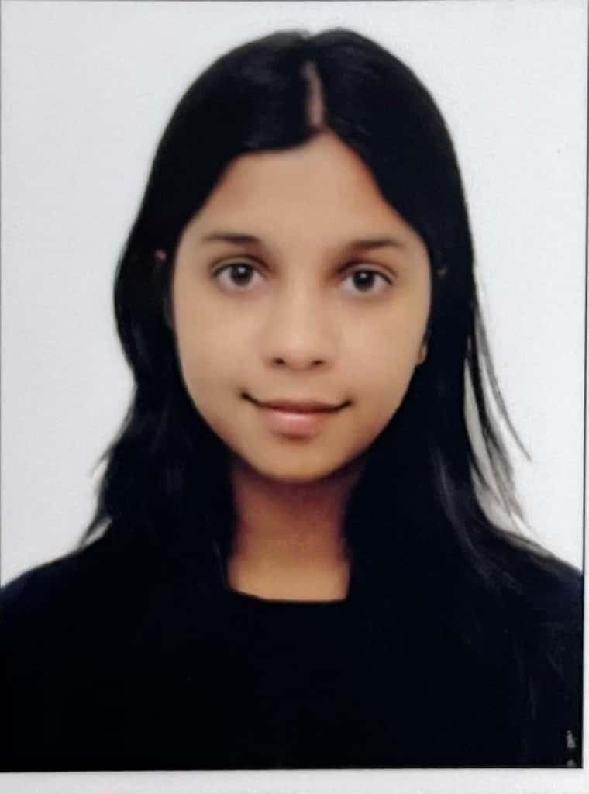

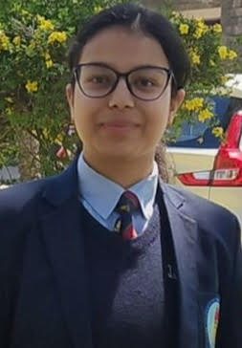
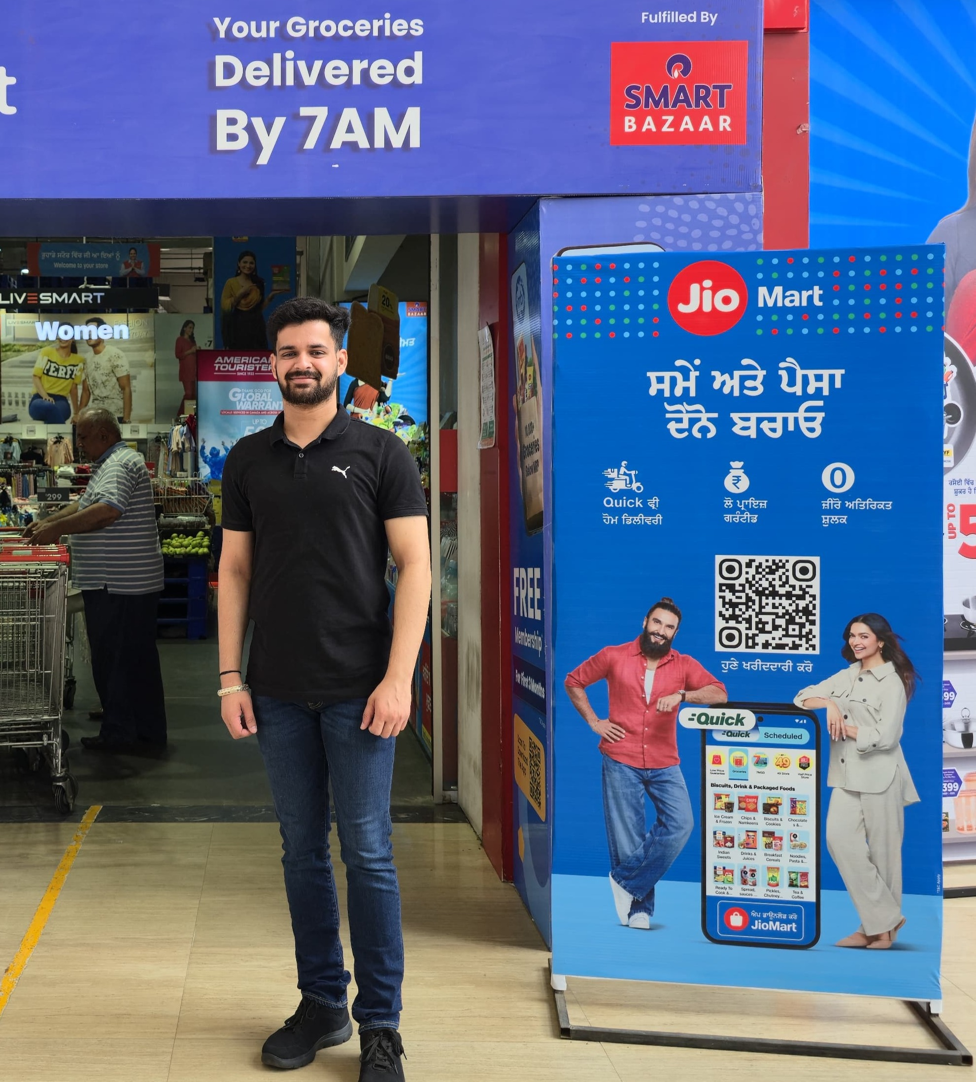



First batch students at their Internship Companies
CA Kamal Yadav & Co.
Cyberforge Academy

Slide 3
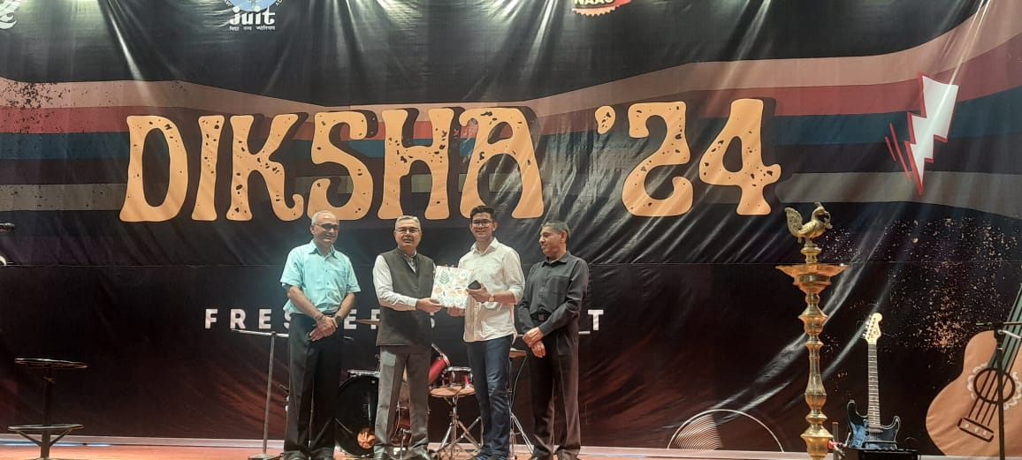
‘23 Batch Student Kartikeya being felicitated by the Vice chancellor for scoring 9+ CGPA

Slide 4
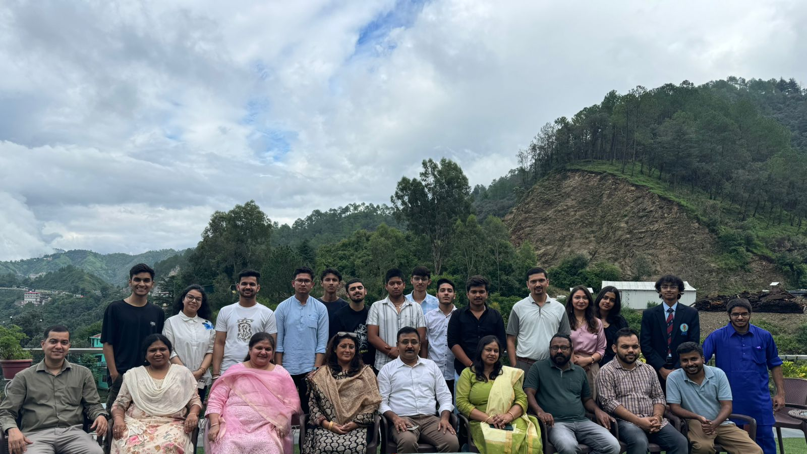
Welcoming the ‘24 batch to JUIT

Slide 5
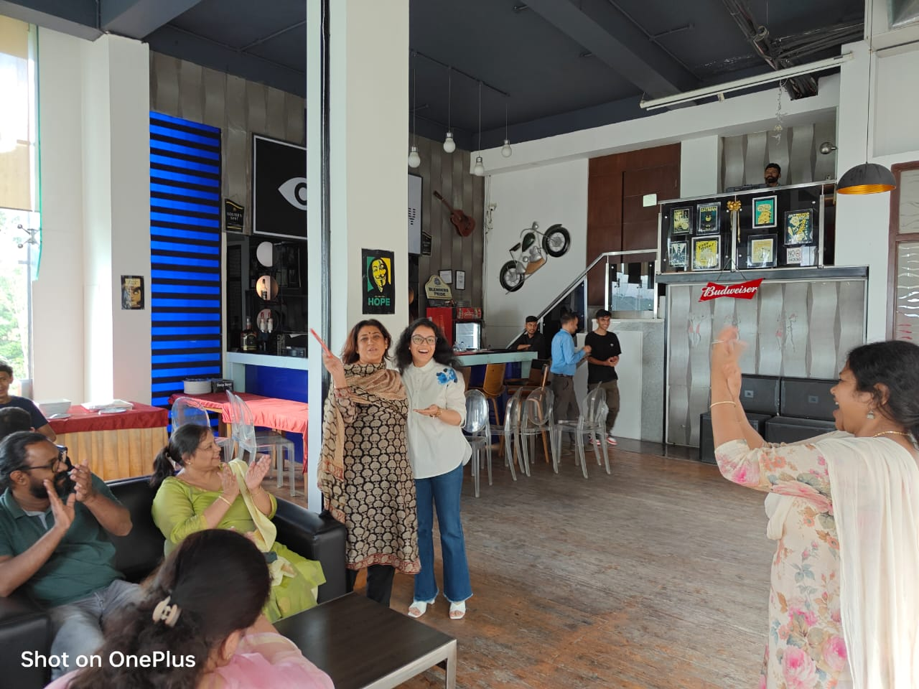

Slide 6


Slide 7


